Slide 1
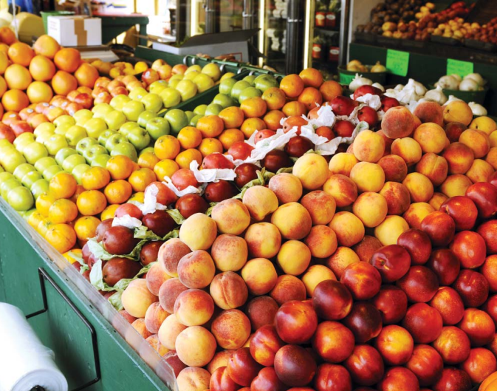
Philly ForagR

Slide 2
The Problem
Obesity and obesity-related diseases and health care costs are a growing problem.
Adult obesity rate in Philadelphia is 32.2%; among African Americans, it’s 38.4%.
Studies show limited access to healthy food and lack of exercise are contributing factors to the obesity crisis.

Slide 3

A Solution
Notes:
Update Screenshot

Slide 4

Follow us: @PhillyForagR
facebook.com/PhillyForagR

